Slide 1
Forecasting the Weather

Slide 2
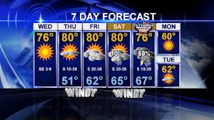
Weather
The state of the atmosphere at a given time and place, with respect to variables such as temperature, moisture, wind speed, and air pressure.

Slide 3
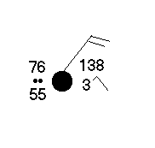
STATION MODEL
A station model is a small circle that shows the location of a weather station. The station model is surrounded by a set of symbols and numbers, which represent weather data.

Slide 4
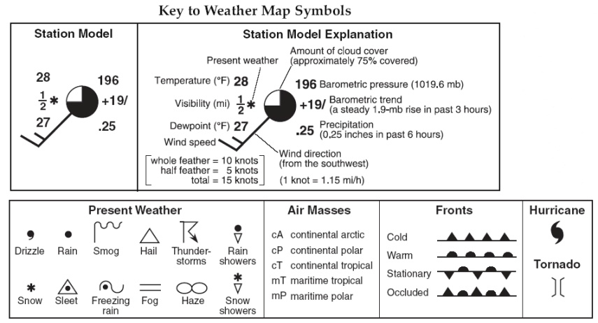
Key to Weather Map Symbols

Slide 5
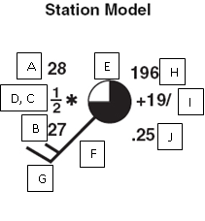
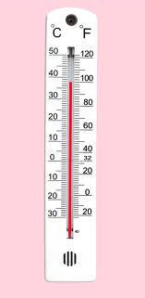
Temperature (F)
A. Temperature is measured in ⁰ F.

Slide 6
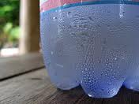
Dewpoint (F)
B. The dew point is the temperature to which a volume of humid air must be cooled for water vapor to change into liquid water.

Slide 7
Present Weather
C. The present weather symbol shows the current weather which normally is obstructing the visibility at the time of observation.

Slide 8
Visibility in Miles
D. The visibility itself is shown as a number, in the unit of miles in the United States. It describes how far the observer can see at that time.

Slide 9
Cloud Cover
E. If the circle is completely filled in, it is overcast. If conditions are completely clear, the circle is empty. If conditions are partly cloudy, the circle is partially filled in.

Slide 10
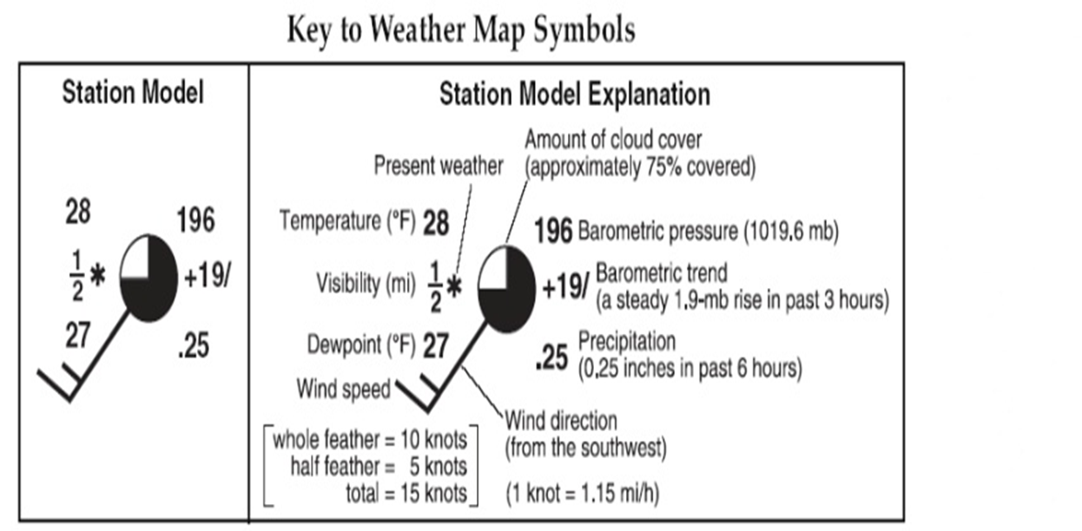
Wind Direction
F. Winds are shown as blowing from the direction that the tail is drawn. Measured in knots.

Slide 11
Wind Speed
G. The wind barb shows the speed using "flags" on the end.
* Each half of a flag depicts five knots
* Each full flag depicts 10 knots
* Each pennant (filled triangle) depicts 50 knots.

Slide 12
Air Pressure
H. On the top right corner of the model for a surface weather map is the air pressure in millibars (mb).
*Pressure range is 960mb to 1040 mb

Slide 13
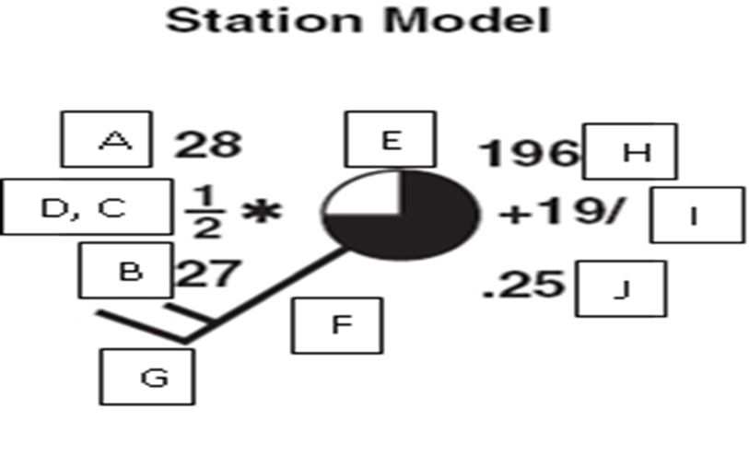
Precipitation
J. Rain, snow, sleet and hail. Measures precipitation in inches for the last 6 hours.

Slide 14
Now Lets Practice!
Please get one of the station model handouts off of the table and work with your partner to try identify each section of the station model.

